Slide 1



I’m Gary, and I’ll be volunteering
I’ve loved computers since I was very little. My first computer was an Apple ][ (1977).
The Apple got me interested in programming. It was satisfying to get the computer to do something. I learned BASIC, Pascal, and 6502 assembly language.
I have been in the industry for 26 years. I used to work on Adobe Flash, which was used for many early Internet games and cartoons.
On the job, it was satisfying to know lots of people used software I worked on, and even made their own creative projects using our software.
Today, I’m a Software Architect at Zendesk, a maker of customer support software. Our main office is in San Francisco by Civic Center BART.

Slide 2
Calling Methods without Parameters

Slide 3
What is a method?
A method is an action defined for a class that all instances of that class (objects) will support.
Methods can:
Provide access to an attribute of an instance
Update an attribute of an instance
Do something new and interesting with the information stored in an instance
Methods are called using the "." operator, which allows access to the public methods of a class.

Slide 4
An example… what number is printed?
// Dog.java public class Dog {
private int age; // an attribute
public Dog(int dogAge) { // constructor
age = dogAge;
}
// a method that updates an attribute.
// returns nothing
public void makeOlder(int years) {
age += years;
}
private int dogYears() { // an internal method
return 7*age;
}
// a method that retrieves an attribute
public int getAge() {
return dogYears();
}
}
// TestDog.java
public class TestDog {
public static void main(String[] args) {
Dog goodBoy = new Dog(5);
goodBoy.makeOlder(2); int age = goodBoy.getAge();
System.out.println(age);
}
}

Slide 5
Method declarations
Method declarations, such as public void makeOlder(int years) { … }
Define whether the method is accessible to the outside world (public / private)
Public methods are available externally (e.g. goodBoy.getAge()) while private methods are not (calling goodBoy.dogYears() in main will cause an error)
Determine what the method returns
Void methods return nothing
String methods promise to return Strings, int methods to return ints
Defines the variables (parameters) passed to the method
To be described in the next section
Define the body of the method
The body is the statements of code that will execute when the method is called.

Slide 6
Abstraction – keeping things simple
One of the core concepts in computer science is abstraction. Abstraction means that you only need to understand how to interact with an object–you don’t need to understand how the code is actually implemented behinds the scenes.
E.g. as a user, I should be indifferent between the following implementations:
Option 1
private int dogYears() {
return 7*age;
}
public int getAge() { return dogYears();
}
Option 2
public int getAge() {
return (age + age + age + age + age + age + age);
}
Option 3
public int getAge() {
return 7*age;
}

Slide 7
The power of abstraction
Abstraction accomplishes two things:
It keeps things simple, minimizing what you need to know to write a program
It makes it possible for the class owner to change the technical implementation of the method without impacting its use
e.g., option 3 may be faster for a computer to calculate than option 2… the programmer may want to switch their implementation from 2 to 3. Abstraction means that the user won’t notice a difference (besides faster code)

Slide 8

NullPointerException
A variable Dog dog; points to an instance of class Dog.
It starts out not pointing to any Dog, with the special value null.
You have to use new Dog to construct a Dog instance that the variable can point to.
If you don’t initialize a variable to point to a Dog instance, and you try to call a method, NullPointerException will be thrown.
Dog badDog; // badDog == null badDog.getAge(); // throws NullPointerException
Dog goodDog = new Dog(3); // goodDog points to instance goodDog.getAge(); // no problem
badDog variable
null
goodDog variable
Dog instance
age
3

Slide 9
Instance and static methods
Instance methods act upon instances of a class. We first create an instance and then call on one of its instance methods.
String t = "blue”;
t.substring(0,2); // "bl”
Static methods aren’t bound to a particular instance of a class. They are called by naming a class following by the dot operator:
String.valueOf(1234); // "1234”
So what does public static void mean?

Slide 10
Methods with Parameters

Slide 11
Write a function that prints a greeting
public class Person {
String name;
public Person(String personName) {
name = personName;
}
// Greeting
public void greet() {
System.out.println(name + " says: Hello, world!”);
}
}

Slide 12
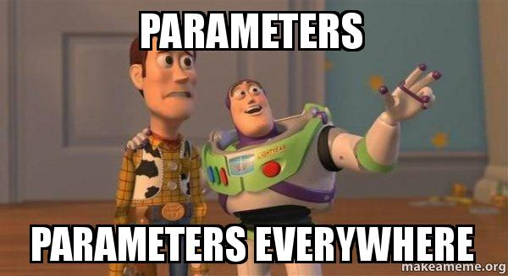
Use parameters!
// Person.java
public class Person {
private String name;
public Person(String personName) {
name = personName;
}
// Greeting
public void greet() {
System.out.println(name + " says: Hello, world!");
}
// Greet a particular person
public void greet(String otherName) {
System.out.println(name + " says: Hello, " + otherName + "!”);
} }

Slide 13
Calling methods with parameters
// TestPerson.java
public class TestPerson {
public static void main(String[] args) {
Person amy = new Person("Amy");
amy.greet("Ted"); // Prints "Amy says: Hello, Ted!"
amy.greet("Thursday"); // Prints "Amy says: Hello, Thursday!"
Person bob = new Person("Bob");
bob.greet("Amy"); // Prints "Bob says: Hello, Amy!"
}
}

Slide 14
Definitions
Formal Parameter (parameter) -The variable declared in the method header
public void greet(String name)
Actual Parameter (argument) - The value passed in a method call
amy.greet("Ted");

Slide 15
Method Overloading
Overloaded methods are two or more methods in the same class that have the same name but different parameters.
// Person.java
public class Person {
private String name;
public Person(String personName) {
name = personName;
}
// Greeting
public void greet() {
System.out.println(name + " says: Hello, world!");
}
// Greet a particular person
public void greet(String otherName) {
System.out.println(name + " says: Hello, " + otherName + "!”);
} // Greet a number
public void greet(int aNumber) {
System.out.println(name + " says: How are you, " + aNumber + "?");
}
}

Slide 16
Calling Overloaded Methods
// TestPerson.java
public class TestPerson {
public static void main(String[] args) {
Person amy = new Person("Amy”);
amy.greet(); // Prints "Amy says: Hello, world!”
amy.greet("Ted”); // Prints "Amy says: Hello, Ted!”
amy.greet(12); // Prints "Amy says: How are you, 12?”
}
}

Slide 17
Method signatures
In Java, the method signature is the method name and just the types of the parameters. It doesn’t include return type, parameter names, or public/private. For the method declaration
public void addCustomer(String name, String address, int age) {...}
The method signature is:
greet(String, String, int)
A Java class cannot have two methods with the same signature. The Java compiler needs method signatures to figure out which overloaded method to call.
OK, signatures different:
int square(int x) { return x*x; }
double square(double x) { return x*x; }
Error, signatures are the same:
int square(double x) { return x*x; }
double square(double y) { return y*y; }

Slide 18
Practice!

Slide 19
More Exercises
Write three different implementations for a single static method triple. The method should take in a number N and return triple its value. Should the method signatures differ across your implementations? Why or why not?
If one of these methods was implemented as part of the class Number, how would it be called?
Now create a Number class with a constructor that accepts a number and stores it in a private variable. Create a triple instance method that returns three times that value. How does this instance method differ from the static method you defined earlier?

Slide 20
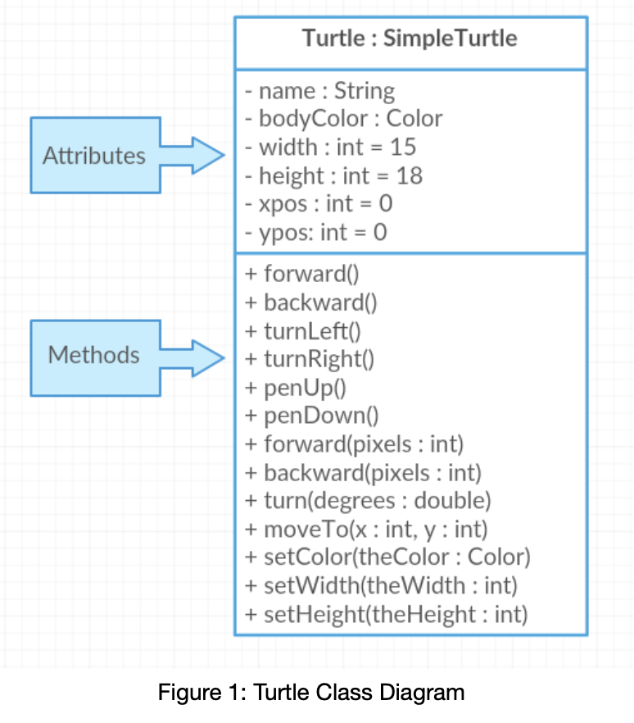
Turtle Class
Color Class
This is a standard Java class
This is an example of abstraction in action!
Color has overloaded constructors: Color(float r, float g, float b) Color(int r, int g, int b)
Color has instance methods: int getRGB()
Color has static methods too: static int HSBtoRGB(float hue, float saturation, float brightness)
Color has static member variables for common colors, e.g., Color.red, Color.gray, Color.white

Slide 21
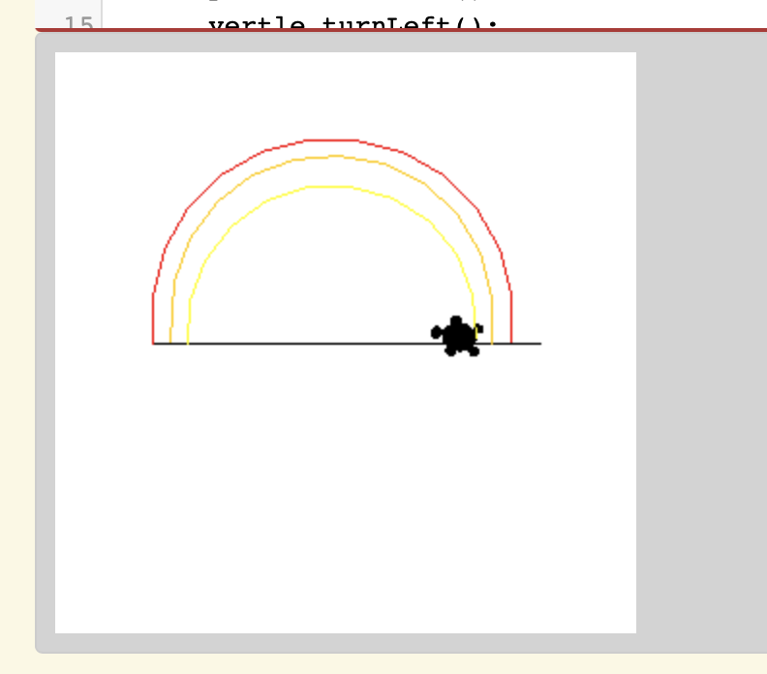
Extra Challenge: Make a cool design!

